Slide 1
The Student Feedback App
Giovanni Toffoli and Mariarosaria Manco – LINK srl
KTU, Kaunas, Novembar 29th -30th 2022

Slide 2
Objectives
WE-COLLAB addresses challenges that characterise poorly designed online courses, such as ‘Zoom fatigue’, higher levels of distractibility and information overload.
These slides present the Student Feedback App, which is part of the first result (PR1) of the Erasmus+ WE-COLLAB project.
We had planned the development of an interactive mobile app for providing voluntary, real-time feedback to the teacher during online lectures, with the mediation of an extension of the CommonSpaces platform.
Its use should be especially useful where/when it won’t be possible to perform monitoring based on the neurophysiological sensors addressed by PR4 and PR5.
It will be more interesting and innovative in parallel to sensors’ experimentation: will allow to do, off-line, a fine grained comparison of emotional and cognitive states as drawn from automated analysis of data and from subjective statements.

Slide 3
Methodology
Besides visualizing the students’ reactions in an Event Dashboard, the web platform forwards xAPI statements to a Learning Record Store (LRS).
Ideally, the “vocabulary” of said statements should be consistent with the classification of the emotional and cognitive states to be identified by studies in PR4 and PR5, precisely for the purpose of enabling some comparison and integration of the data collected from different sources. Since those studies require some time to be completed, we had to anticipate something, based on common sense and on the review of other applications, including videoconference tools.
Currently, we use only one xAPI activity type, Event, one xAPI verb, Comment, and a slot of the result element of the xAPI statement to report the specific kind of synchronous reaction to the lecture, more generally to the event.

Slide 4
The repertoire of attendees reactions
This is the current version of the feedback messages repertoire to be sent via a virtual keypad:
go on | slower | louder
pause | repeat | explain
(need) context | (need) example | (need) recap
The 9 reaction types above follow the style of the 4 “persistent reactions” allowed by the Zoom platform (Yes, No, Slow down, and Speed up). They are mostly performative expressions: it might not be trivial to put them in relation with data on inner states of the learner, extracted from the neurophysiological signals.
Note that the well known Wooclap application only allows to say “I’m confused”.

Slide 5
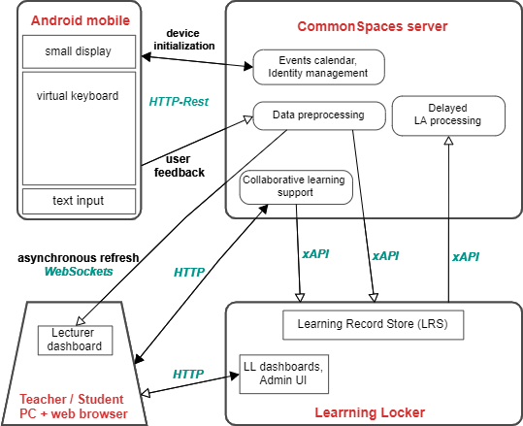
Architecture
a mobile app for an Android smartphone
a Learning Record Store
an integration platform receives feedback, forwards it to the LRS, aggregates and visualizes data
(chat not shown)

Slide 6
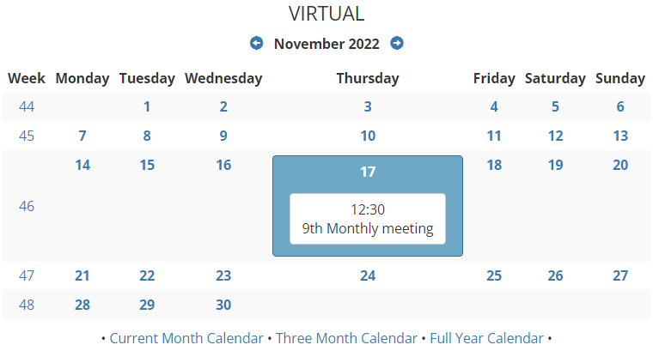
An event in a platform calendar
The lecture, more in general the event, must be registered in the Calendar.
Here the event is just a meeting.

Slide 7
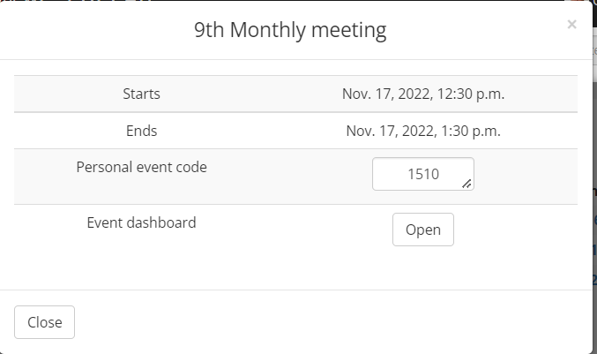
The event detail view
In this case, only the event title and its start and end times are defined.
This view includes a personal event code and the link to the Event Dashboard

Slide 8
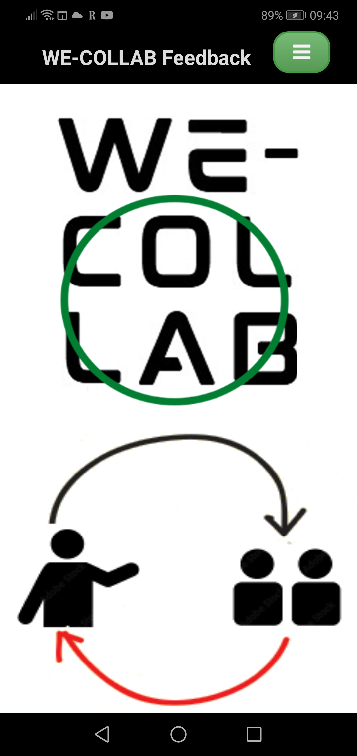
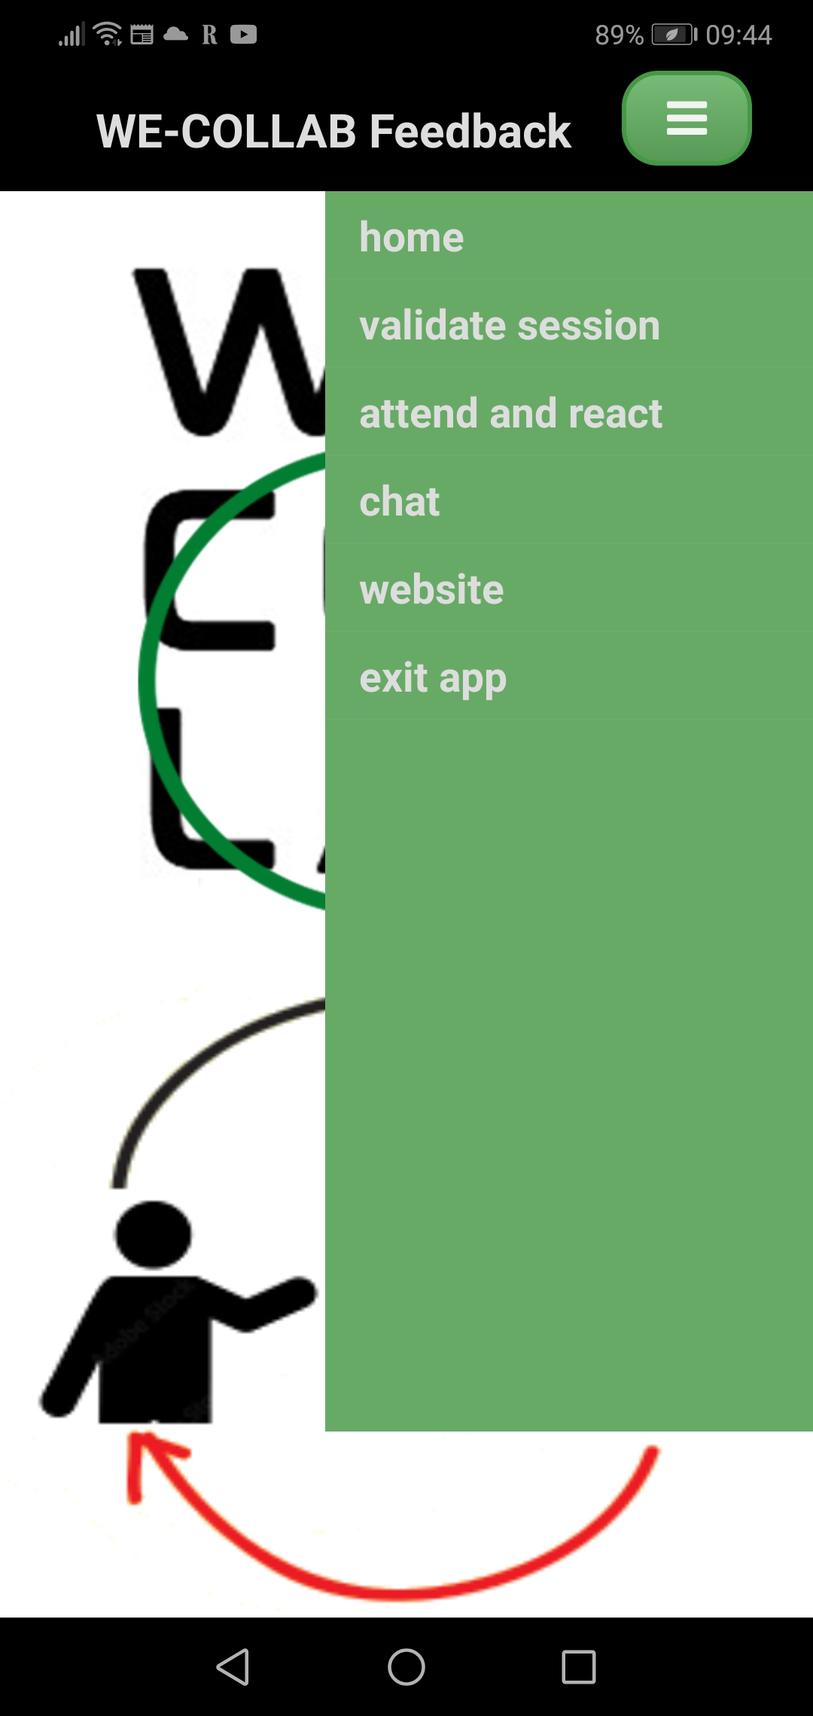
App screens 1 and 2
The cover
The menu

Slide 9
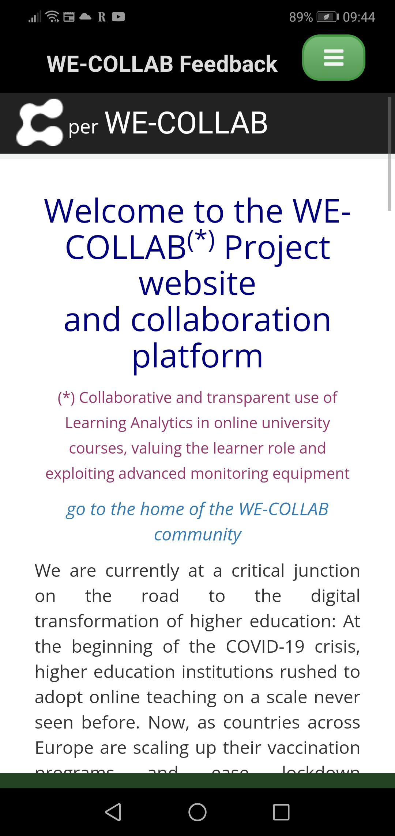
App screen 3
The cover of the WE-COLLAB site in the web view of the app

Slide 10
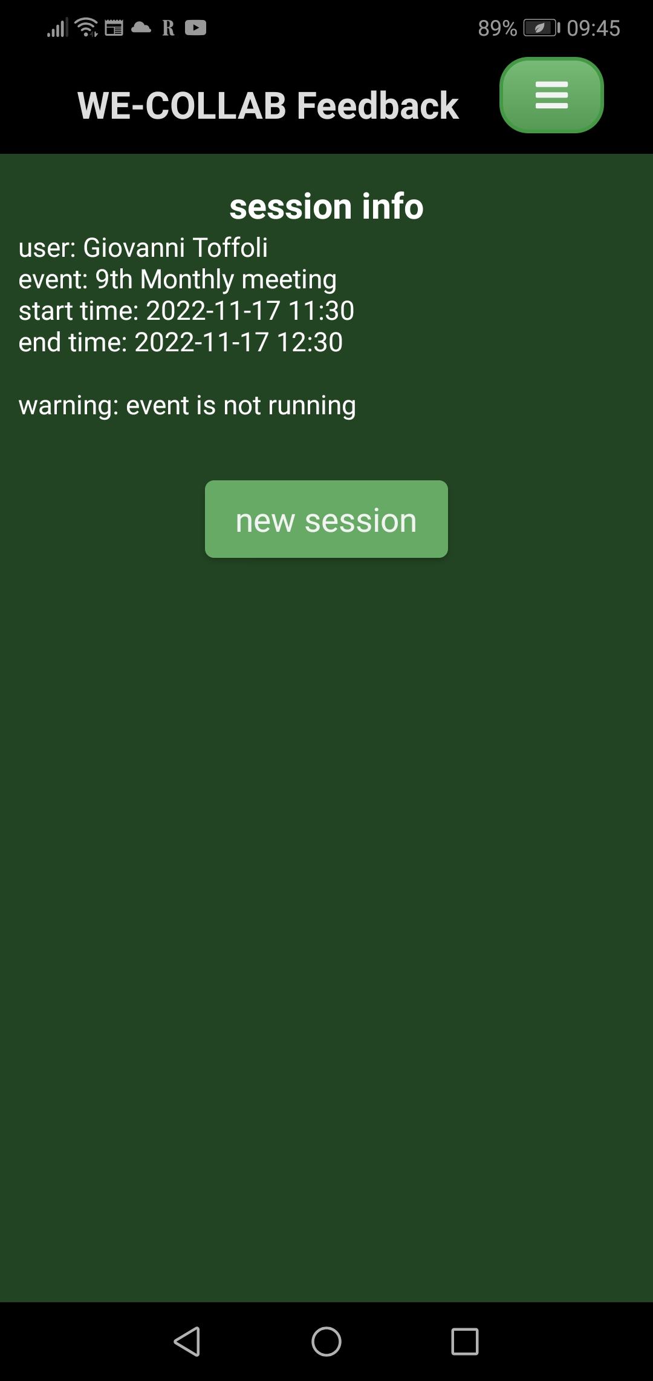
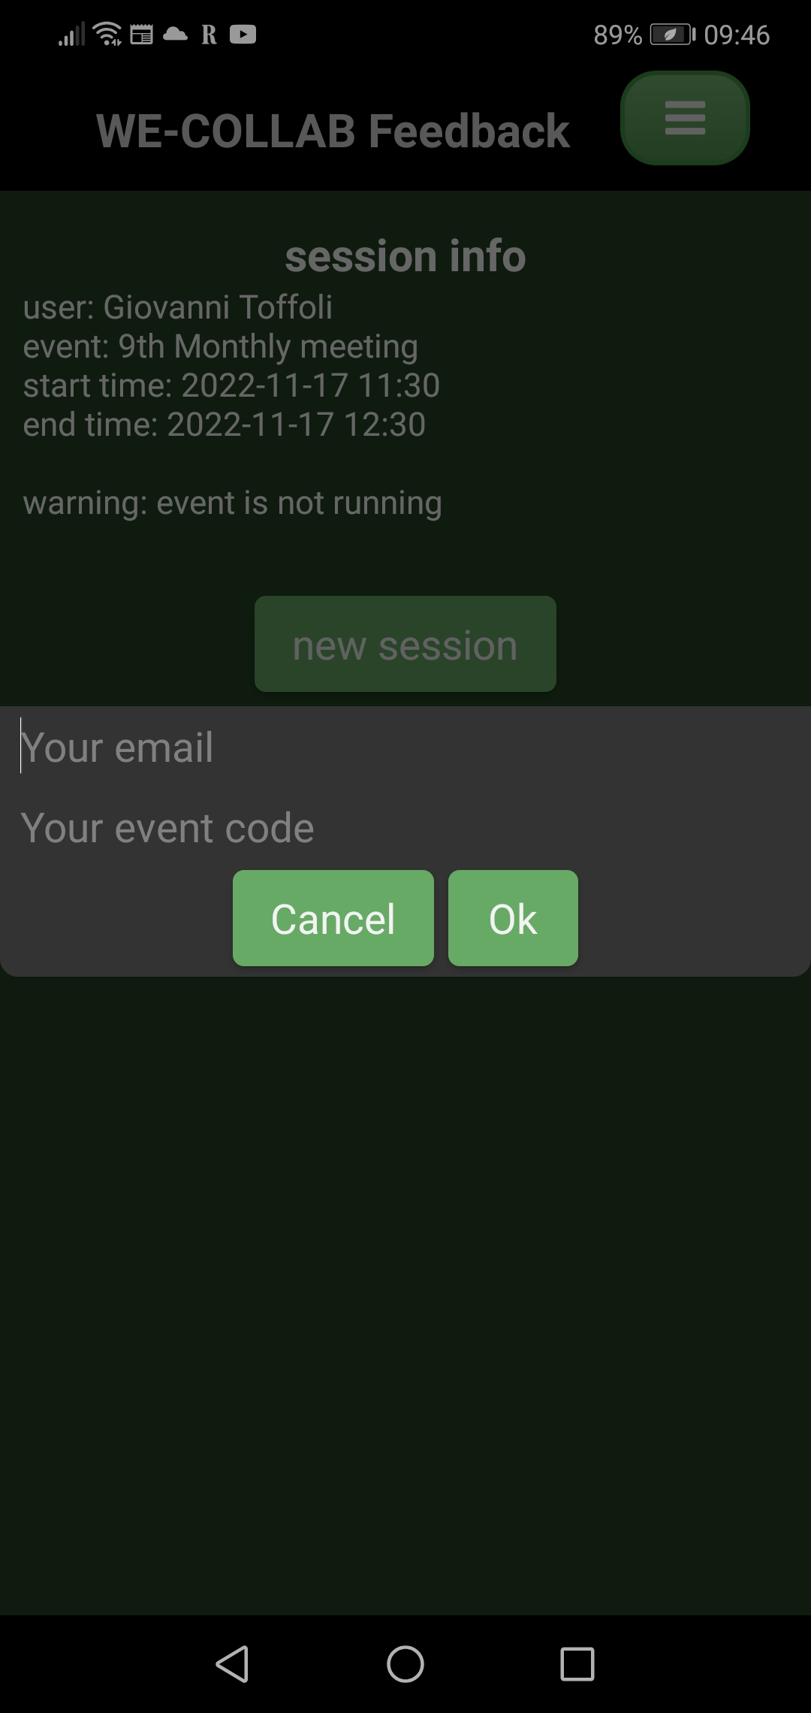
App screens 4 and 5
The current session info
Registering a new event

Slide 11
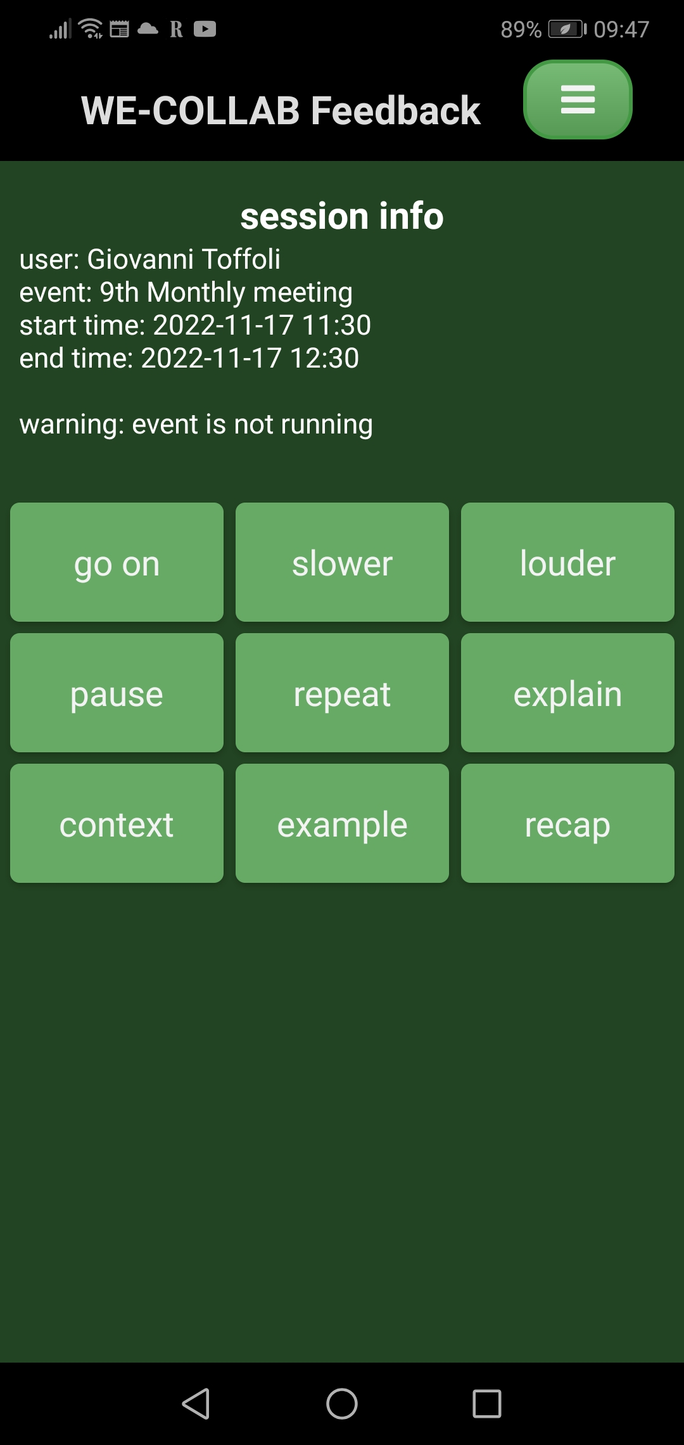
App screen 6
The virtual keyboard for sending reaction messages
note the warning ( but currently time constraints are disregarded )

Slide 12
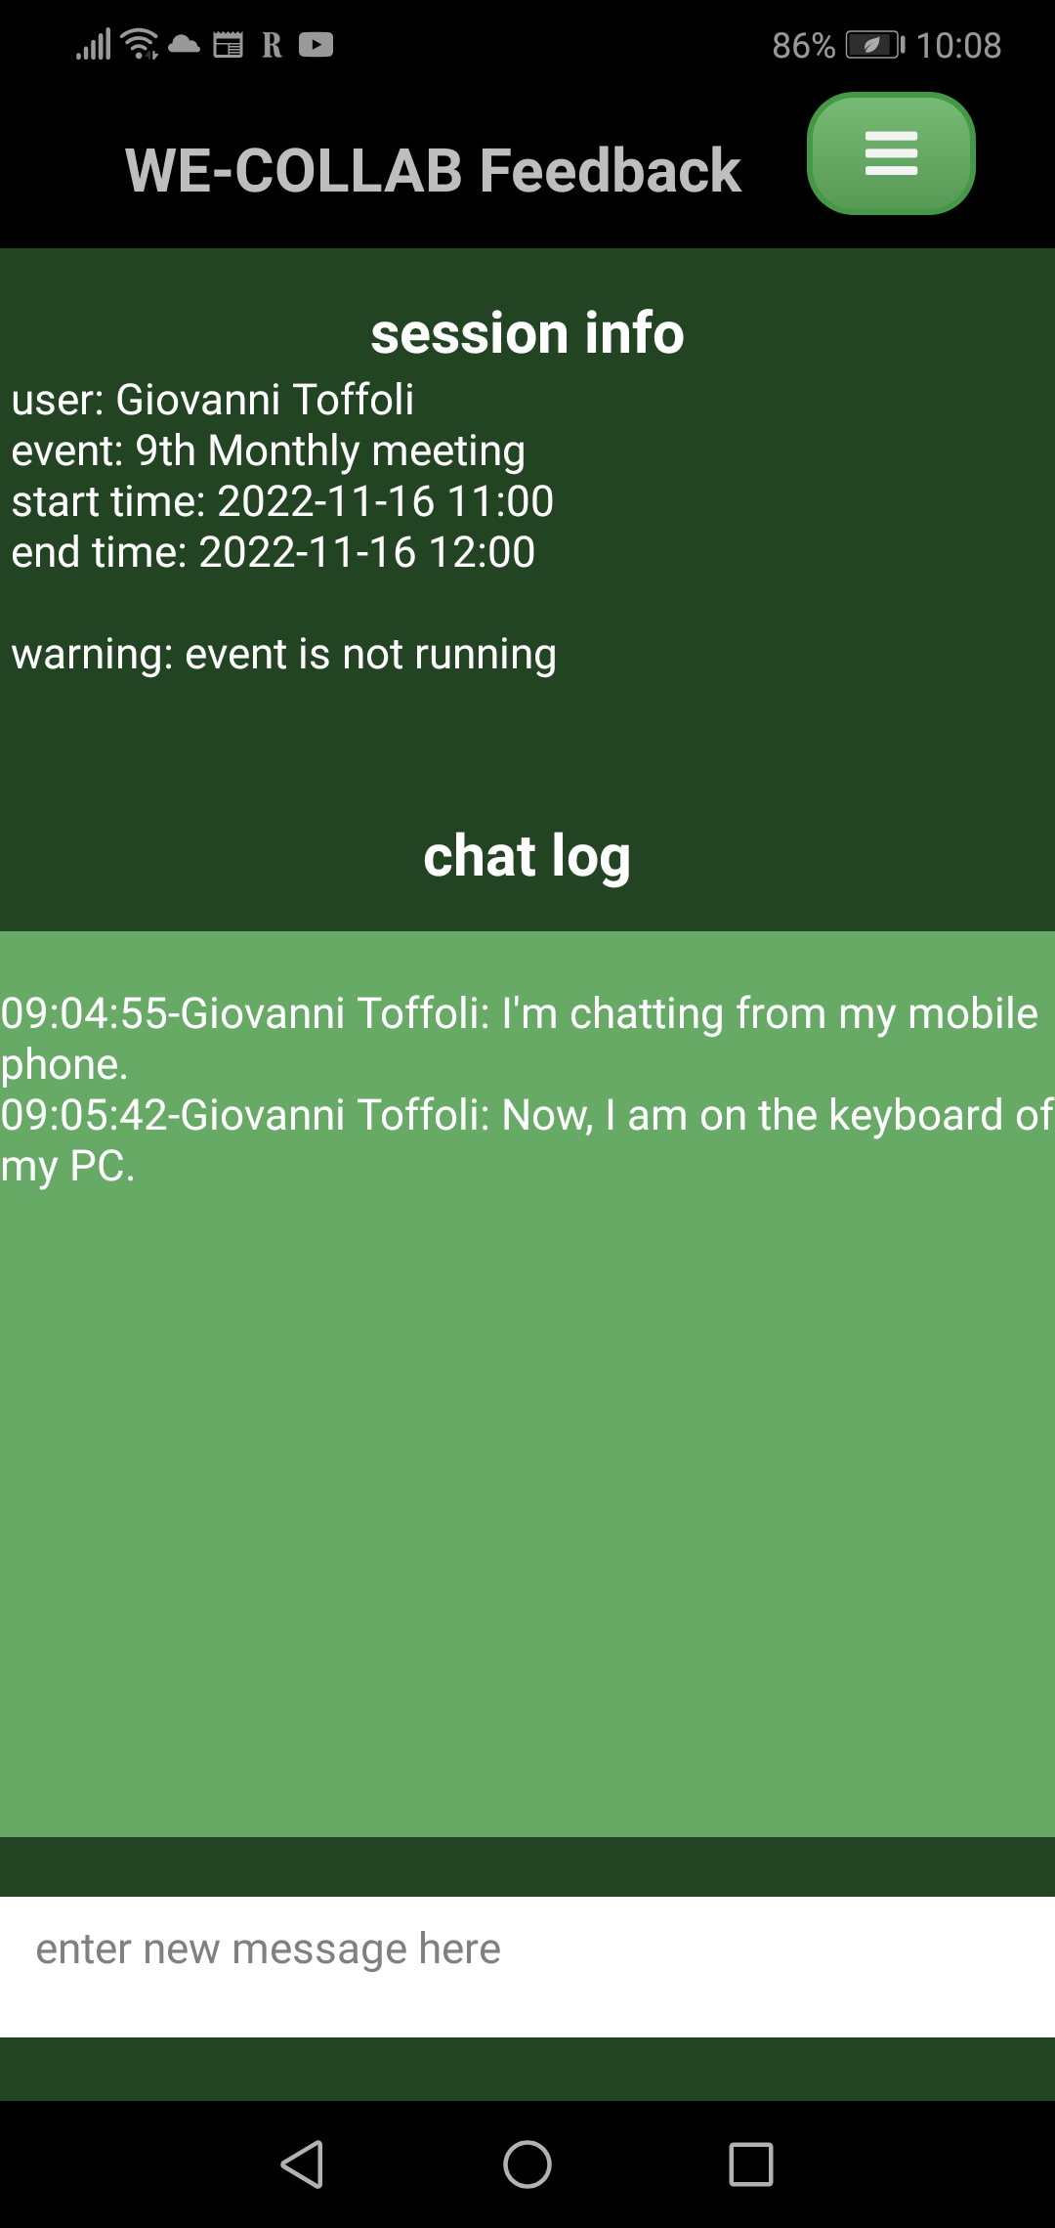
App screen 7
The chat screen
It mirrors the chat pane in the Event Dashboard of the web platform

Slide 13
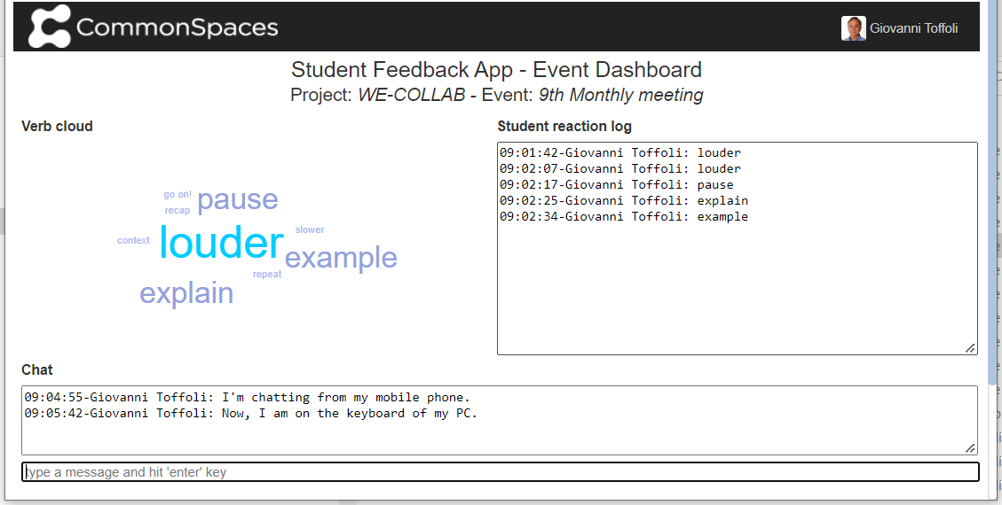
The Event Dashboard in the browser interface
The

Slide 14
Technical details and challenges
The integraton platform, mentioned in the Architecture slide, is an upgrade of the Commons Platform, on which CommonSpaces and the WE-COLLAB mini-site were built; in turn, the Commons Platform relies on the Django framework.
The LRS is a deployment of TRAX LRS.
The major challenges we met:
for the rapid development of the Android app we used the DroidScript IDE; it is very ingenious, but it was the first time we used it;
we had to upgrade the Commons Platform to enable it to create Web Sockets; these are required to establish asynchronous communication channels with the browser, to ensure the refresh in real-time of the Event Dashboard and the chat screen of the mobile app.

Slide 15
Erasmus + for 2021 for Key Activity 2: Collaborative partnerships in the field of higher education
Approved : EUR 371,219.00
Duration: 1.2.2022.-31.1.2025.
Coordinator: University of Rijeka, Faculty of Economics and Business
Partners: Universidad Autonoma de Madrid (Spain),
Universita degli studi di Roma la Sapienza (Italy),
Copenhagen Business School (Denmark),
National Technical University of Athens (Greece),
Brainsigns SRL (Italy),
LINK SRL (Italy),
Kaunas University of tehnology (Lithuania)
The European Commission support for the production of this project does not constitute an endorsement of the contents which reflects the views only of the authors, and the Commission cannot be held responsi­ble for any use which may be made of the information contained therein.

